Slide 1
Northern Ireland
The Troubles

Slide 2
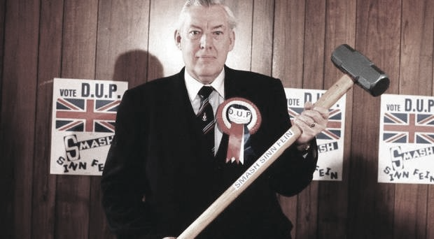
In 1963 a Presbyterian pastor by the name of Ian Paisley appeared on the scene. Paisley & his followers were irate when O’Neill expressed condolences on the death of Pope John XXIII. From that point forward, they never trusted O’Neill to remain true to the cause of Unionists (which was, of course, maintaining Catholic oppression). In 1964 Paisley “forced the Royal Ulster Constabulary (RUC) to intervene to remove an Irish tricolor from a window” in a Catholic area of Belfast (Bartlett, p. 497). Four nights of rioting followed.
Some of Paisley’s supporters were evangelicals who felt that some Protestant churches were becoming too conciliatory toward the Catholic church; others weren’t particularly religious but believed that the world’s growing acceptance of differences (the U.S.’s first Catholic president, JFK, had been elected in 1960) was going to change their own in a way that might not be to their advantage.
A change that added fuel to the fear Paisley’s warnings had set ablaze was the emergence of an educated class of Catholics. Remember the Education Act of 1947? The Catholics who had benefitted from that Act had now graduated from college & were pushing back. In the 1960s, Northern Ireland did not have “one man, one vote”; instead, those with “a stake in the country” were given extra votes (Bartlett, p. 499). Those with an extra stake were those who paid more taxes; those who paid more taxes were those who had the best jobs; those who had the best jobs were Protestant. So in Derry, which had a large Catholic majority, the government was controlled by Protestants.

Slide 3
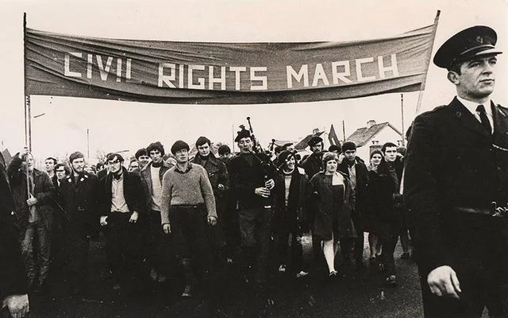
You need to understand that the Catholic situation was very similar to the African American situation here in the 40s and 50s. Catholics were seen as second-class citizens. Protestants got the best jobs & the best housing—well, better than the housing of the Catholics if both were on welfare (or on the dole, as they say in Ireland & the UK). There weren’t separate water fountains (did you know that we had those?), & Catholics didn’t have to sit in the back of the bus, but the oppression was real.
The young, newly educated Catholics weren’t willing to just accept the status quo. In 1967 they formed the Northern Ireland Civil Rights Association (NICRA), & they were smart enough to start out moderately. They avoided responding in kind to Paisley & his followers & focused on concrete goals, the most notable being to obtain a one man, one vote policy, to end gerrymandering, and to get fair allocation of public housing (Bartlett, p. 500).
Inspired by the U.S. civil right marches, NICRA sponsored a civil rights march in August 1968 in Dungannon, County Tyrone. Everyone, Catholic & Protestant, was uneasy, but it went off well enough. So they planned another march in October in Derry.
Derry, the second largest (which isn’t saying much) city in Northern Ireland, had played a prominent role during plantation (remember why the Protestants call it Londonderry?) and had been at the center of the war between Catholic James & Protestant William. Marching in Dungannon was one thing; Derry was a totally different story.

Slide 4
Paisley & his followers planned a countermarch, so William Craig, minister for Home Affairs, banned all marches. But NICRA went on with its march, & the RUC (Royal Ulster Constabulary) used water cannons to break it up. They were actually unprepared to deal with the situation, which ended up in a riot as the RUC attacked the marchers.
There were no fatalities, but the attacks inspired radical Marxist students at Queens University in Belfast. They decided to organize a march from Belfast to Derry (70 miles) & set out on January 1, 1969. There were only a few dozen at the beginning, but as they were harassed & rerouted along the way, other students & Republicans joined them because, as we’ve seen, the Irish don’t like overreactions. There were several hundred by the time they reached Derry.

Slide 5
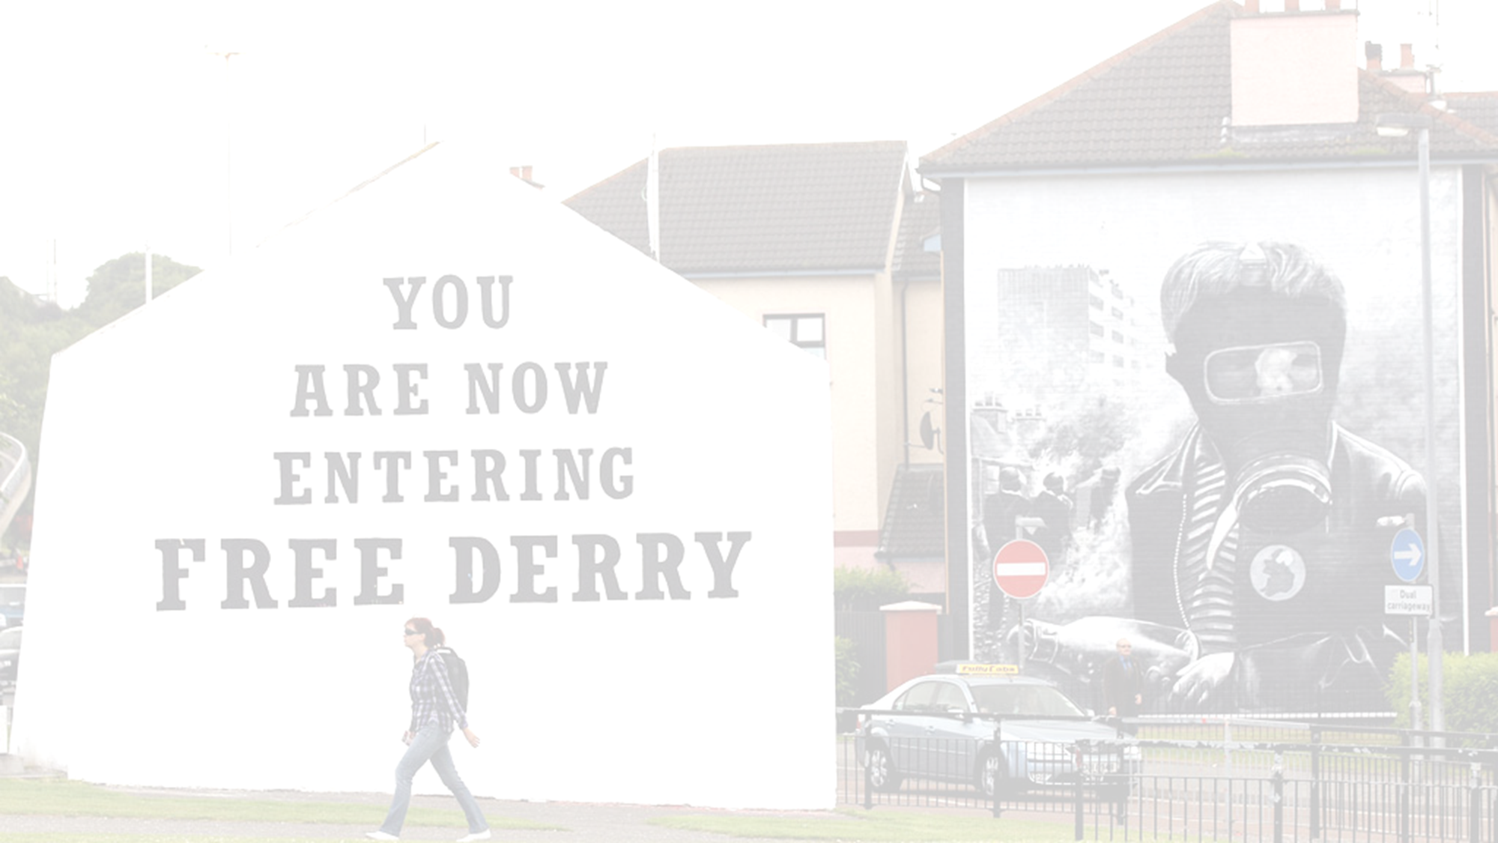
But an associate of Paisley’s had organized an ambush just outside the city walls, and Protestant militants beat the marchers. There were no fatalities, but when the bruised & broken marchers made their way into the city (which was primarily Catholic, remember), a riot began.
There had been no deaths during any of the marches, but it was clear that Terence O’Neill had no control over the growing tensions, & he resigned as prime minister in April. And his successor, James Chichester-Clark, wasn’t an improvement.
Civil disturbances escalated. A nationalist section of Derry declared itself autonomous, put up barricades to keep out the RUC, & called itself Free Derry. Rioting throughout the country was common, & for the first time, a bomb was used (the headquarters of a television station being the target). And then in August…do you remember when the Apprentice Boys shut the gates to the city walls so that James’ troops could not enter? Back in 1689. That event is commemorated every year on August 12 in Derry—which is predominately Catholic, remember.

Slide 6
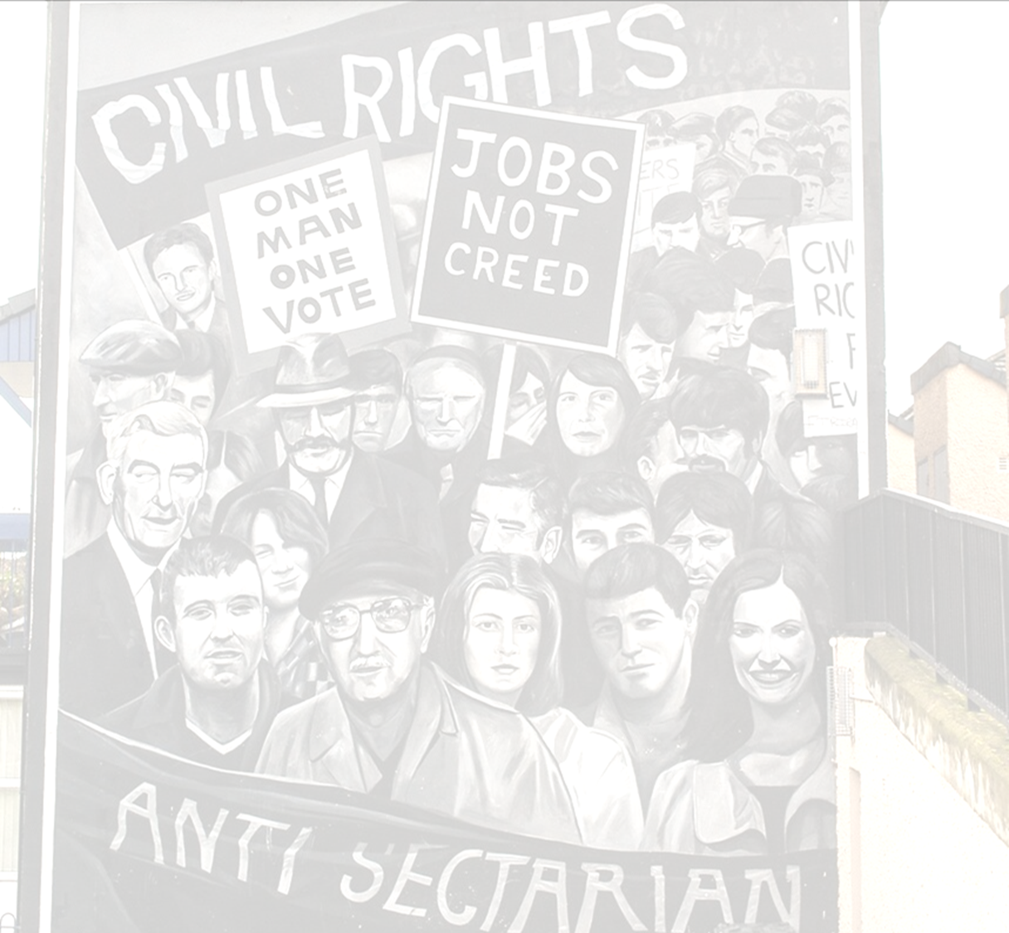
Even today, sectarian parades ALWAYS require a strong police presence. In 1969 the nationalists & loyalists were, as usual, throwing rocks at each other, & nationalists threw them at the RUC. The Bogside, a Catholic neighborhood that was part of Free Derry, was at the edge of the parade route, & although the parade didn’t pass through it, it passed close to it, and the hurling of rocks & nails intensified. The police moved in and tried to break down the barricades between the parade route & Free Derry, & from the roofs of apartment buildings, people threw petrol bombs at them. This skirmish is now known as the Battle of the Bogside.
The rioting continued throughout the following day as well, and on the 14th, the British prime minister sent the army in. But no sooner did they have the rioting in Derry under control than rioting broke out in Belfast. There had been hundreds of injuries in Derry but no deaths, but the RUC used machine guns in Belfast. The rioting escalated even more quickly in Belfast than it had in Derry, & the army had to take control there as well.

Slide 7
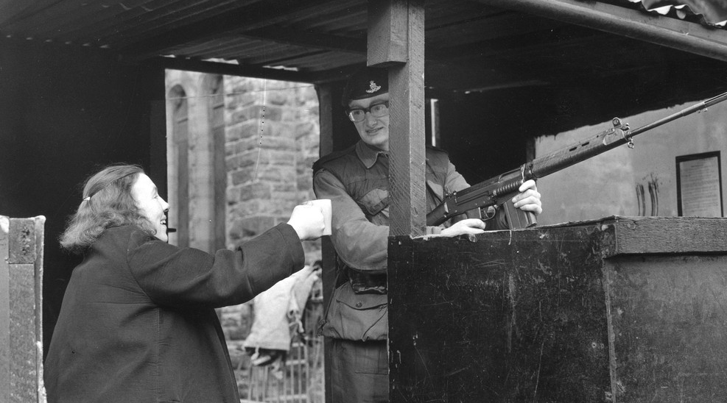
In 1969, the RUC & some loyalist paramilitary groups launched what they considered a pre-emptive strike against Catholic areas in Belfast. There was barely any response from the IRA, & at the Sinn Fein annual congress 5 months later, the IRA split. The more conservative (everything’s relative) group became the “official” IRA, & the other group became the Provisional IRA (called “Provos”) and took up arms against the loyalists, seeing themselves as the defenders of the Catholics of Northern Ireland.
At first the British army (brought in when rioting broke out in Derry, remember) and the Provos worked well together. The Catholics were grateful for the protection of the army & frequently offered the soldiers tea and sandwiches. But the congeniality didn’t last—surprise—and Bartlett lists the stages of the breakdown of the peace:

Slide 8
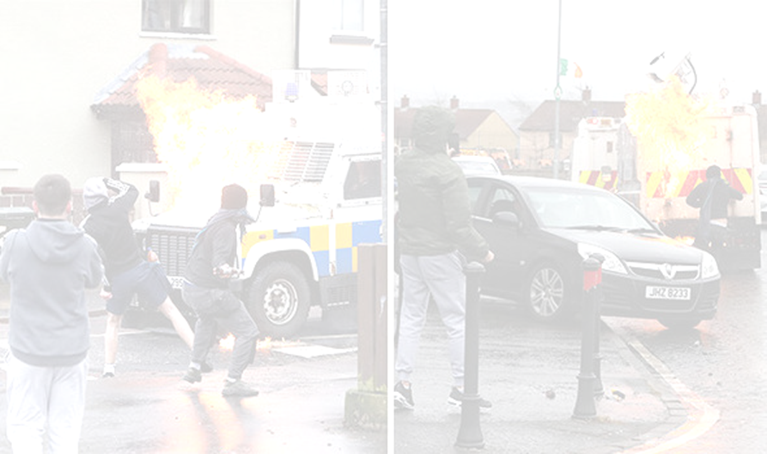
A Falls Road (a Catholic area) curfew, July 3-5, 1970. The British Army broke into homes in search of shipments of IRA arms. Rioting ensued. The curfew was imposed, & the army moved in, ransacking some 3000 homes and causing all manner of destruction in the homes. Six civilians were killed.
The Provos went on the offensive in 1971. A soldier was killed, & later 3 were deliberately lured from a pub & shot. Belfast loyalists held a demonstration to demand the *internment of Provo leaders. The arrest of 342 people, some of whom, as it turned out, had nothing to do with the Provos, sparked more violence. People on both sides, as well as soldiers, died.
(*Internment is the imprisonment of people without benefit of trial.)
Bloody Sunday
(pp. 510 – 13)

Slide 9
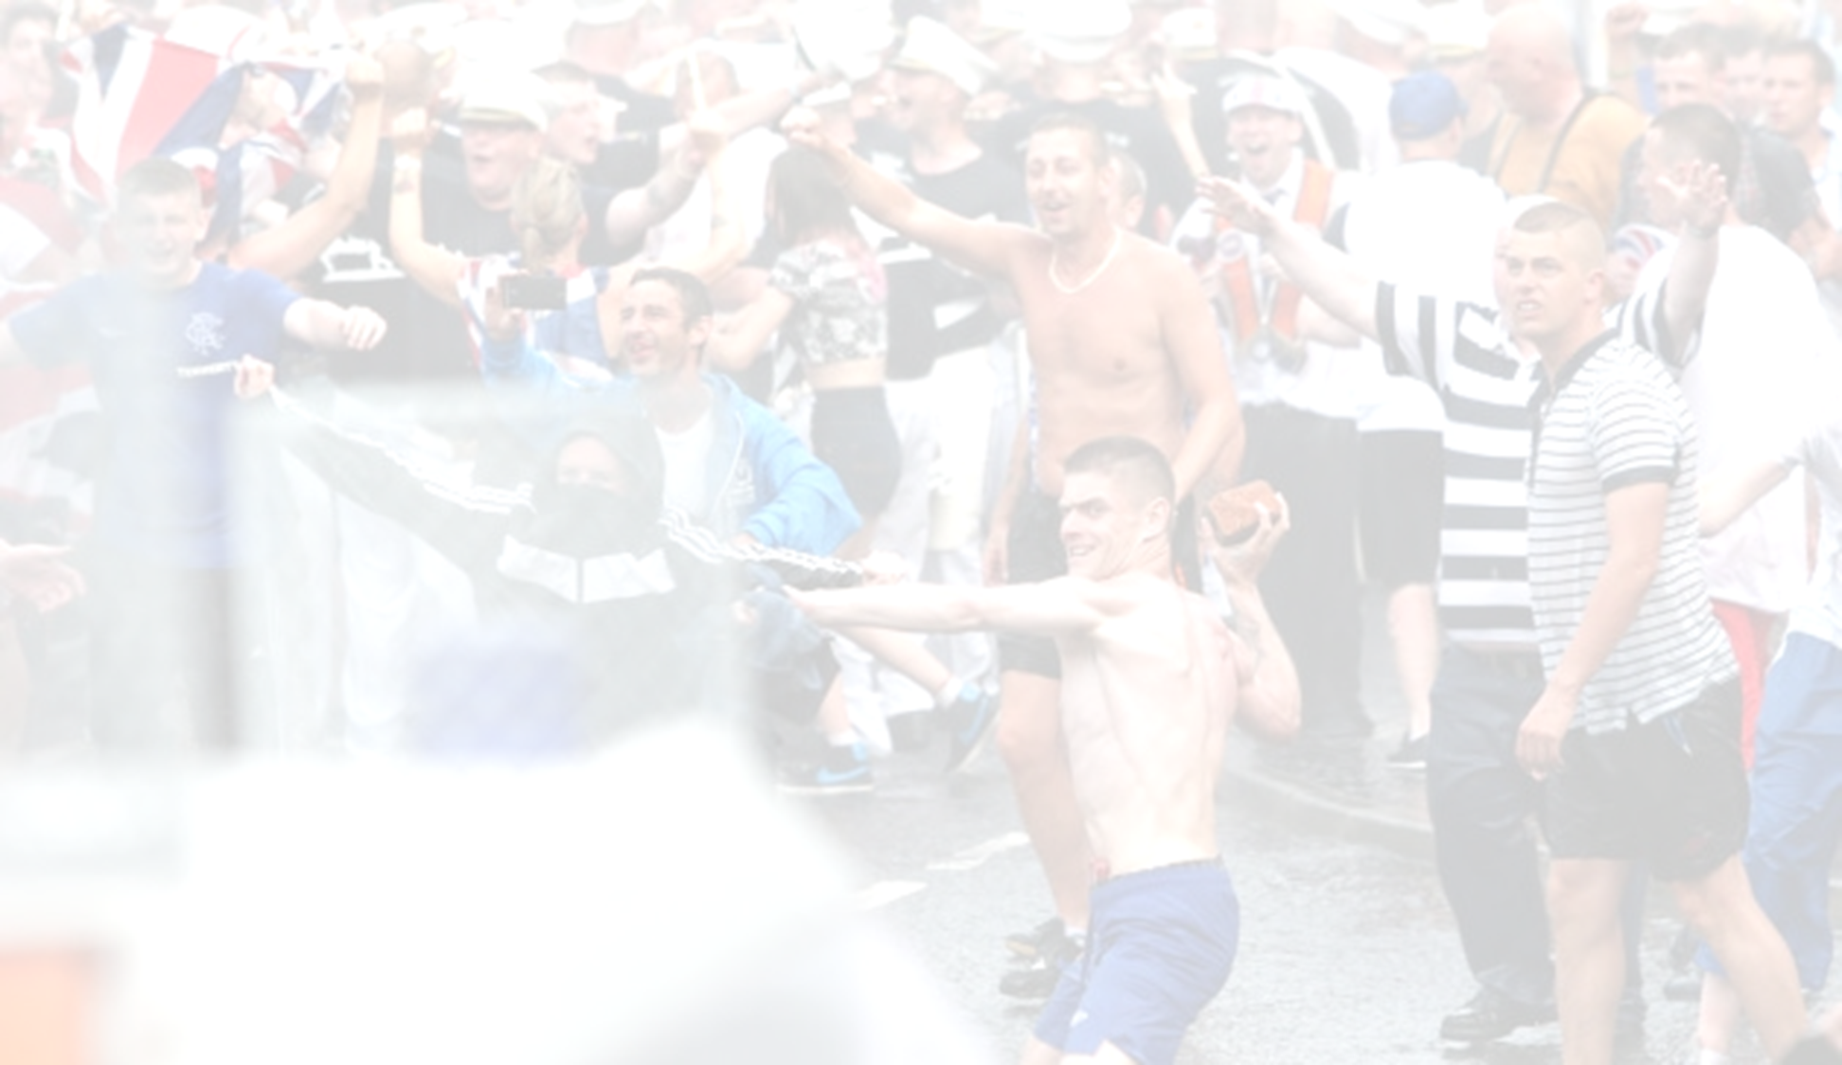
Sunday, January 30, 1972, was the date of a second anti-internment march held in Derry. Marches had been banned, but NICRA went ahead with its plans. The army barricaded part of the route to keep the protestors from reaching their goal—the guildhall. People—most notably young people—threw rocks at the soldiers, an everyday occurrence in Northern Ireland in those days. Soldiers responded with rubber bullets & water cannons.
The paratroopers of a unit that had been brought in to control violence were sent in to arrest the rioters. They moved in & fired at people at barricades, killing six. People began to flee, but the paratroopers kept shooting. Seven more people were killed, at least one of them shot in the back. Another was shot & killed when he was trying to help a fallen friend.
Twenty-six people were shot, 13 fatally, & one died months later of his injuries. The initial inquiry found the paratroopers innocent of any unprovoked action, but the UK government, 16 years later, began an inquiry that lasted 12 years & concluded that all victims were unarmed (except for rocks) and that the actions of the paratroopers were completely unjustified.

Slide 10
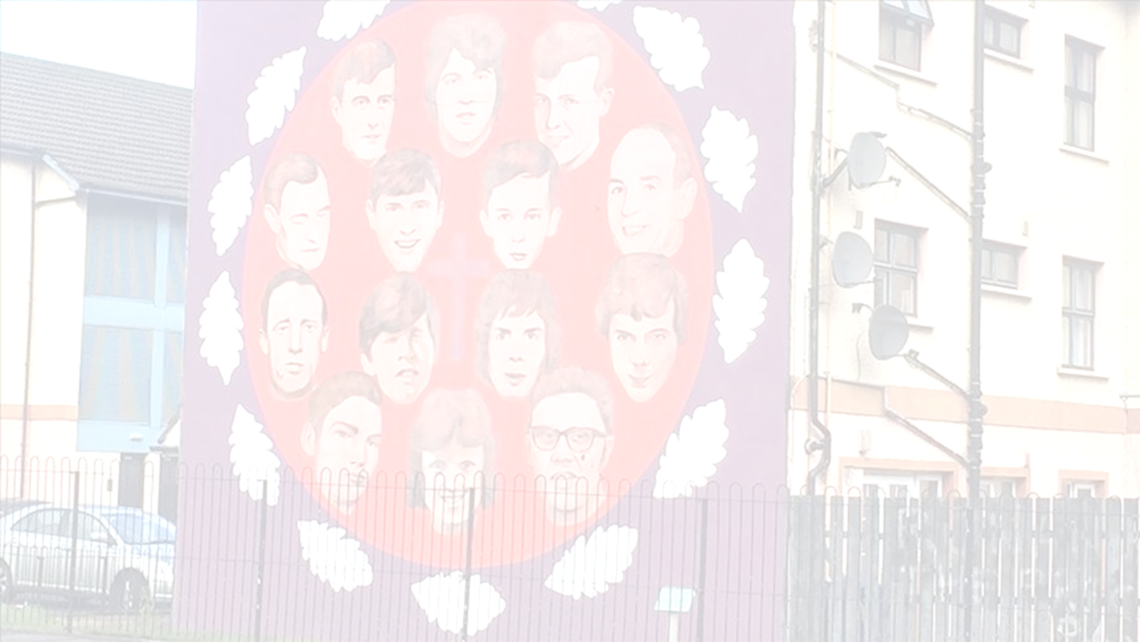
Bloody Sunday escalated what had become essentially a terrorist civil war. The IRA (the Provos, although few people outside the island could differentiate among the various divisions of the IRA) was the most notorious of all the terrorist groups, because it bombed civilian sites, but it was by no means the only group, & both sides had terrorist organizations.
By now, home rule had been suspended, & Northern Ireland was under direct rule from London. Nobody was happy about that. The loyalists wanted to rule their own country; republicans didn’t trust the British parliament any more than they did the loyalists; and Great Britain didn’t want responsibility for the mess.
A proposed power-sharing government among all Northern Irish parties fell through. Violence continued to escalate. In Bartlett’s words

Slide 11
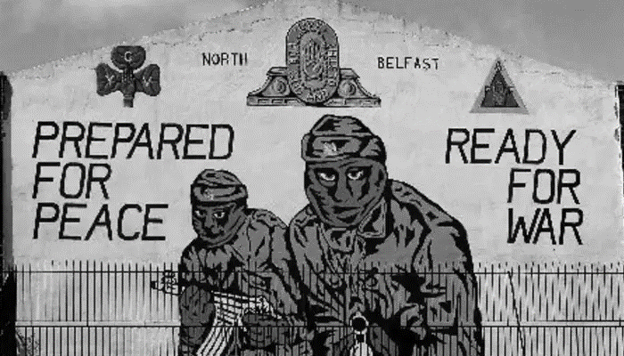
Over a thousand deaths were recorded between internment [1971] and the fall of the power-sharing executive [1974], with the IRA being responsible for 55 per cent, loyalists for 33 per cent and the security forces for 12 per cent…. Armed with its newly invented weapon, the car-bomb, [IRA] members had set about the near systematic reconfiguration of the centres of most northern Irish towns, very often causing civilian casualties in the process. Within a few years all but 20 out of Derry’s 150 shops had been blown up, and it was little better in Belfast city centre. In retaliation, loyalist death squads bent on the torture/murder of Catholics – any Catholic would do – roamed the streets of North Belfast and the byways of mid-Ulster with apparent impunity and with deadly effect. Particularly grisly were the murders in the early 1970s of some nineteen Catholics in Belfast by a gang known as the Shankill Butchers (pp. 519 – 20).

Slide 12
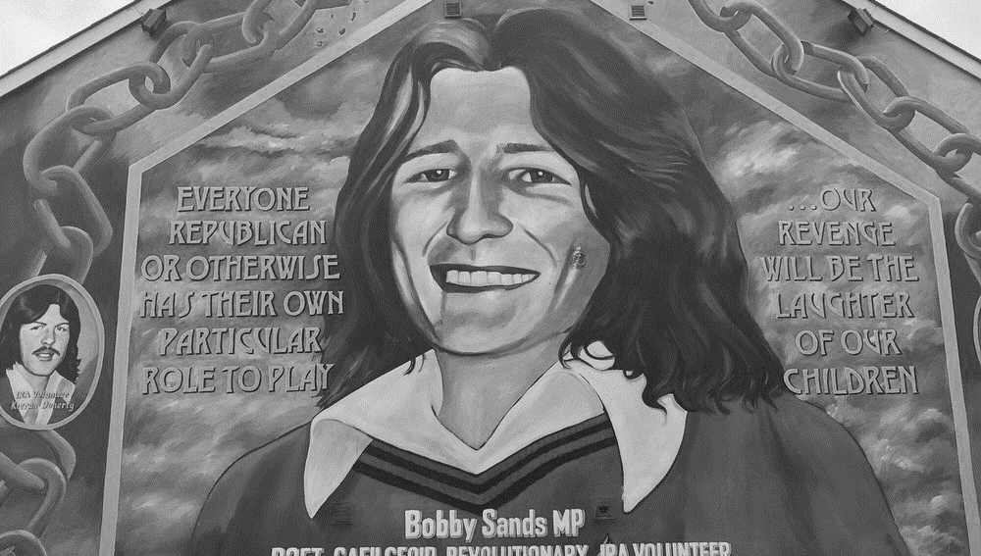
In 1974, the IRA upped its game: it began planting bombs in England. Civilians were killed when bombs exploded in pubs. A British ambassador was shot & killed.
The purpose of the IRA campaign against England was to get the British army out of Northern Ireland. They finally did get a small concession: internment would be ended. Prisoners would be put on trial. However, if they were convicted, they would be treated as criminals, not as political prisoners. In protest, the criminals/political prisoners went on hunger strikes. Bobby Sands was the first of 10 prisoners to die, having refused food for 66 days.
The deaths had no effect at all on the British government’s stance, but of course, they raised the furor of Catholics/republicans. And the violence continued.

